Slide 1
Class Diagram
Overview
Components of Class Diagram with Examples
Elements of Class Diagram
Relationships in Class Diagram
Project
Sehrish Aqeel
www.aisciences.io

Slide 2
Overview
Imagine you were given a task of drawing a family tree. The steps you would take would be:
Identify the main members of the family
Determine how they are related to each other
Identify the characteristics of each family member
Find relations among family members
Decide the inheritance of personal traits and characters
A class diagram is similar to a family tree.

Slide 3
Class Diagram
A class diagram consists of a group of classes and interfaces reflecting important entities of the business domain of the system being modeled, and the relationships between these classes and interfaces.
The classes and interfaces in the diagram represent the members of a family tree and the relationships between the classes are analogous to relationships between members in a family tree.
A class diagram is a pictorial representation of the detailed system design.
A thing to remember is that a class diagram is a static view of a system.

Slide 4
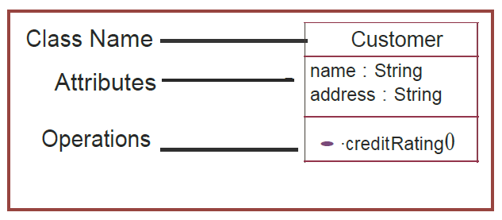
Components of a Class Diagram
Classes are composed of three things:
Name,
Attributes, and
Operations.

Slide 5
Components of a Class Diagram
The standard class diagram is composed of three sections:
Upper section: Contains the name of the class. This section is always required, whether you are talking about the classifier or an object.
Middle section: Contains the attributes of the class. Use this section to describe the qualities of the class. This is only required when describing a specific instance of a class.
Bottom section: Includes class operations (methods). Displayed in list format, each operation takes up its own line. The operations describe how a class interacts with data.

Slide 6
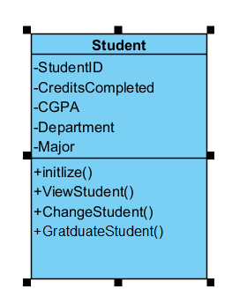
Example

Slide 7
Quiz
Make Class named as Course.
Add Attributes to the class.
Add Operation to the class.

Slide 8
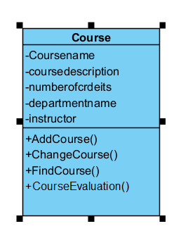
Quiz Solution

Slide 9
Definition
“Class diagram is a diagram showing a collection of classes and interfaces along with he collaborations and relationships among classes and interfaces.”
Class diagrams are widely used to describe the types of objects in a system and their relationships.
Class diagrams model class structure and contents using design elements such as classes, packages and objects.

Slide 10
Member access modifiers
All classes have different access levels depending on the access modifier (visibility). Here are the access levels with their corresponding symbols:
Public (+)
Private (-)
Protected (#)
Package (~)
Derived (/)
Static (underlined)

Slide 11
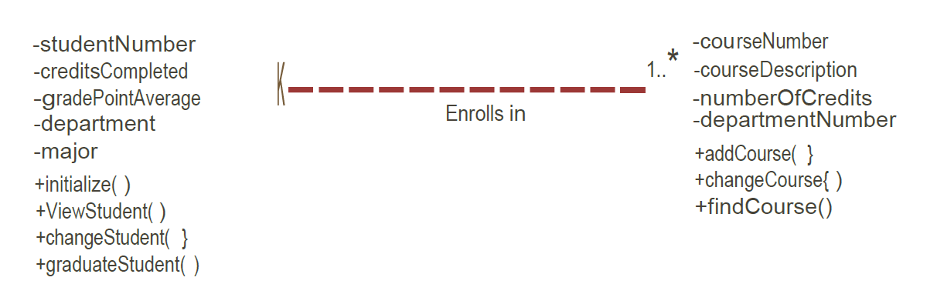

Slide 12
Member scopes
There are two scopes for members: classifiers and instances.
Classifiers are static members while instances are the specific instances of the class.

Slide 13
Quiz
Make Class of Department and Textbook by defining public and private members of the classes.

Slide 14
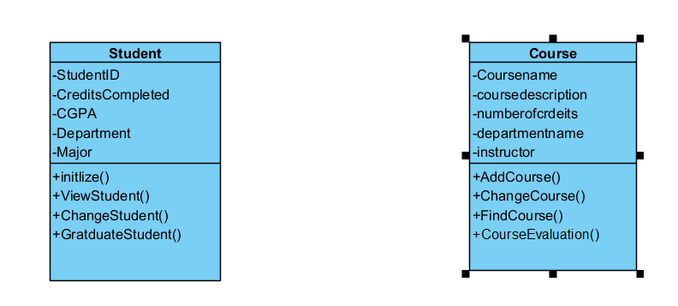
Quiz Solution

Slide 15
Additional class diagram components
Signals: Symbols that represent one-way, asynchronous communications between active objects.
Data types: Classifiers that define data values. Data types can model both primitive types and enumerations.
Packages: Shapes designed to organize related classifiers in a diagram. They are symbolized with a large tabbed rectangle shape.
Interfaces: A collection of operation signatures and/or attribute definitions that define a cohesive set of behaviors. Interfaces are similar to classes, except that a class can have an instance of its type, and an interface must have at least one class to implement it.

Slide 16
Additional class diagram components
Enumerations: Representations of user-defined data types. An enumeration includes groups of identifiers that represent values of the enumeration.
Objects: Instances of a class or classes. Objects can be added to a class diagram to represent either concrete or prototypical instances.
Artifacts: Model elements that represent the concrete entities in a software system, such as documents, databases, executable files, software components, etc.

Slide 17
Relationships in Classes
Aggregation means one object is the owner of another object.
Composition means one object is contained in another object.

Slide 18
Quiz
In same Class Diagram model, add classes of Assignment and Exam and link them with other classes by drawing suitable relationship.

Slide 19
Relationships in classes
The association relationship is the most common relationship in a class diagram. The association shows the relationship between instances of classes. For example, the class Order is associated with the class Customer.

Slide 20
Relationships in classes
The multiplicity of the association denotes the number of objects that can participate in the relationship.
For example, an Order object can be associated to only one customer, but a customer can be associated to many orders.

Slide 21
Quiz
Draw Association relationship in between Customer and Order Class.

Slide 22
Dos and Don'ts
Classes in a class diagram should be descriptive and must be named after business entities.
Using business entities as names ensures greater readability of class diagrams.
Relationships between classes may not be apparent in the first iteration.
Revise and refine your class diagrams to determine possible relationships during each iteration.
Designing is an incremental process and class diagrams are updated as the system gets built.
Hence, do not try to capture and freeze the class diagrams of a system in the first pass.

Slide 23
Quiz Project
ATM SYSTEM

Slide 24
Project
Hotel Management System

